Slide 1

T20 World Cup 2022
DATA ANALYSIS
Presenter-SAKSHI

Slide 2

INTRODUCTION
Every sports event generates a lot of data which we can use to analyze the performance of players, teams, and many highlights of the game. The dataset I am using for the T20 World cup 2022 analysis.

Slide 3

Importing the necessary Python libraries
import pandas as pd
import plotly.express as px
import plotly.graph_objects as go
import plotly.io as pio
pio.templates.default = "plotly_white"

Slide 4

Load files into a DataFrame
Use Pandas to read CSV files
data = pd.read_csv('D:\\t20-world-cup-22.csv')
print(data.head())

Slide 5
venue team1 ... best bowler best bowling figure
0 SCG New Zealand ... Tim Southee 3-6
1 Optus Stadium Afghanistan ... Sam Curran 5-10
2 Blundstone Arena Ireland ... Maheesh Theekshana 2-19
3 MCG Pakistan ... Hardik Pandya 3-30
4 Blundstone Arena Bangladesh ... Taskin Ahmed 4-25
[5 rows x 17 columns]

Slide 6
print.tail()
venue team1 ... best bowler best bowling figure
28 Adelaide Oval Bangladesh ... Shaheen Afridi 4-22
29 MCG India ... Ravichandran Ashwin 3-22
30 SCG New Zealand ... Shaheen Afridi 2-24
31 Adelaide Oval India ... Chris Jordan 3-43
32 MCG Pakistan ... Sam Curran 3-12
[5 rows x 17 columns]

Slide 7
print.info()
<class 'pandas.core.frame.DataFrame'>
RangeIndex: 33 entries, 0 to 32
Data columns (total 17 columns):
# Column Non-Null Count Dtype
--- ------ -------------- -----
0 venue 33 non-null object
1 team1 33 non-null object
2 team2 33 non-null object
3 stage 33 non-null object
4 toss winner 30 non-null object
5 toss decision 30 non-null object
6 first innings score 30 non-null float64
7 first innings wickets 30 non-null float64
8 second innings score 30 non-null float64
9 second innings wickets 30 non-null float64
10 winner 29 non-null object
11 won by 29 non-null object
12 player of the match 29 non-null object
13 top scorer 30 non-null object
14 highest score 30 non-null float64
15 best bowler 30 non-null object
16 best bowling figure 30 non-null object
dtypes: float64(5), object(12)

Slide 8
Now let’s look at the number of matches won by each team in the world cup:
figure = px.bar(data),
x=data["winner"],
title=("Number of Matches Won by teams in t20 World Cup 2022")
figure.show()

Slide 9

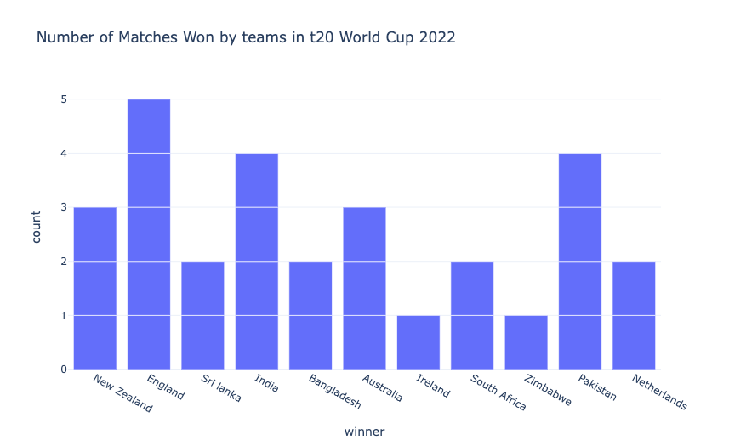

Slide 10


As England won the t20 world cup 2022, England won five matches. And Both Pakistan and India won 4 matches.

Slide 11
Now let’s have a look at the number of matches won by batting first or second in the t20 world cup 2022:
won_by = data["won by"].value_counts()
label = won_by.index
counts = won_by.values
colors = ['gold','lightgreen']
fig = go.Figure(data=[go.Pie(labels=label, values=counts)])
fig.update_layout(title_text='Number of Matches Won By Runs Or Wickets')
fig.update_traces(hoverinfo='label+percent', textinfo='value', textfont_size=30,
marker=dict(colors=colors, line=dict(color='black', width=3)))
fig.show()

Slide 12
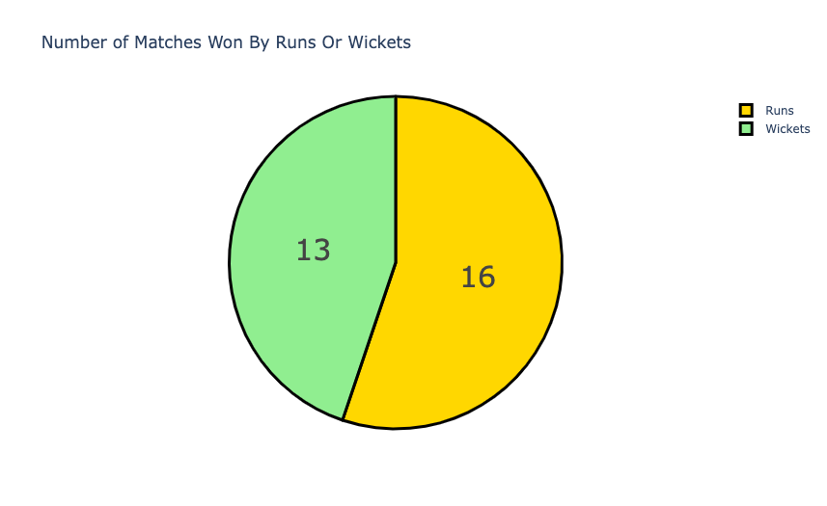

Slide 13

So in the t20 world cup 2022, 16 matches were won by batting first, and 13 matches were won by batting second or chasing.

Slide 14
Now, let’s have a look at the toss decisions by teams in the world cup:
toss = data["toss decision"].value_counts()
label = toss.index
counts = toss.values
colors = ['skyblue','yellow']
fig = go.Figure(data=[go.Pie(labels=label, values=counts)])
fig.update_layout(title_text='Toss Decisions in t20 World Cup 2022')
fig.update_traces(hoverinfo='label+percent', textinfo='value', textfont_size=30,
marker=dict(colors=colors, line=dict(color='black', width=3)))
fig.show()

Slide 15
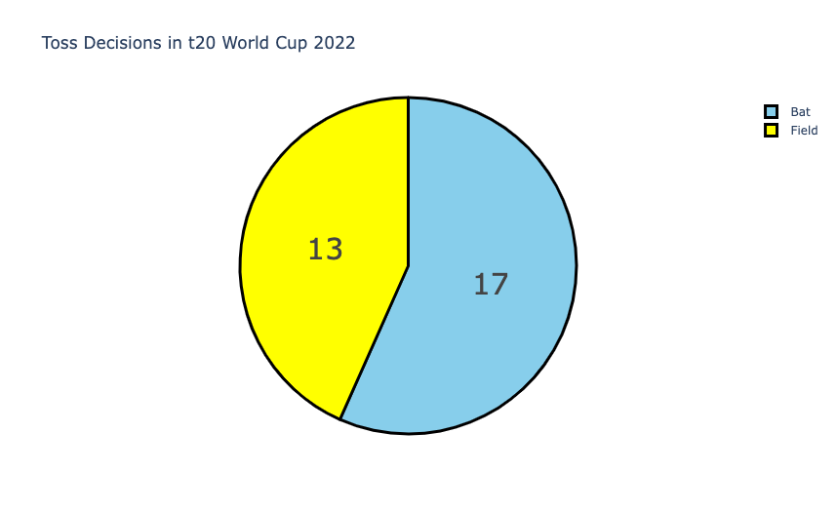

Slide 16
So in the t20 world cup 2022, in 17 matches the teams decided to bat first, and in 13 matches, the teams chose to field first.

Slide 17
Now let’s have a look at the top scorers in the t20 world cup 2022:
figure = px.bar(data,
x=data["top scorer"],
y = data["highest score"],
color = data["highest score"],
title="Top Scorers in t20 World Cup 2022")
figure.show()

Slide 18
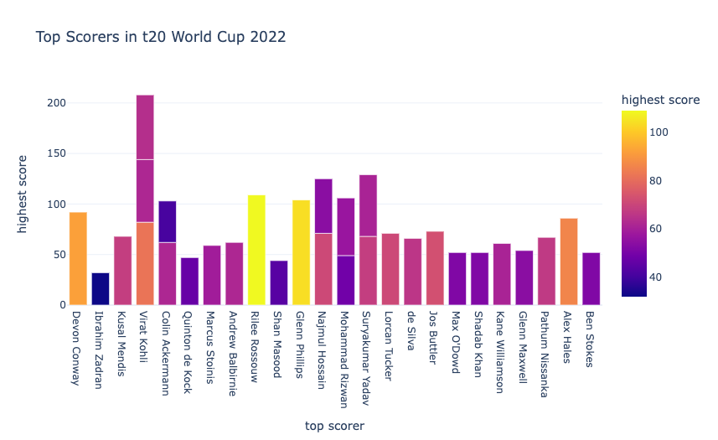

Slide 19
So, Virat Kohli scored the highest in 3 matches. Undoubtedly, he was the best batsman in the t20 world cup 2022.

Slide 20
Now let’s have a look at the number of player of the match awards in the world cup:
figure = px.bar(data,
x = data["player of the match"],
title="Player of the Match Awards in t20 World Cup 2022")
figure.show()

Slide 21
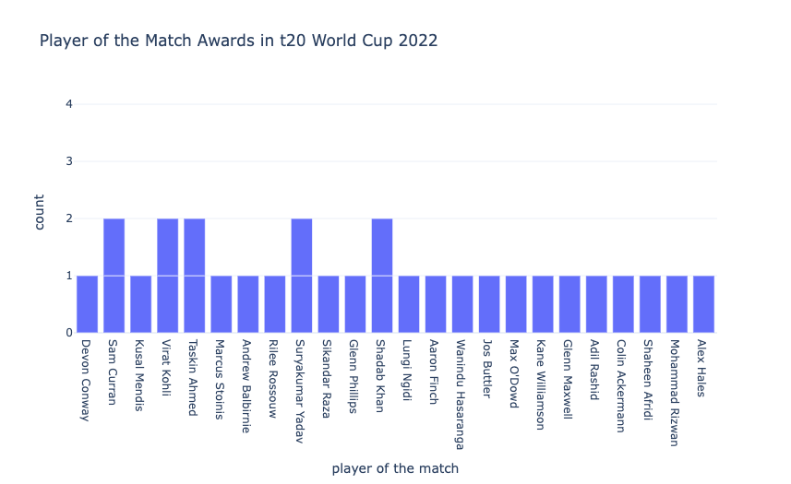

Slide 22
Virat Kohli, Sam Curran, Taskin Ahmed, Surya kumar Yadav, and Shadab Khan got the player of the match in 2 matches. No player got the player of the match award in more than two matches.

Slide 23
Now let’s have a look at the bowlers with the best bowling figures at the end of the matches:
FIGURE = PX.BAR(DATA,
X=DATA["BEST BOWLER"],
TITLE="BEST BOWLERS IN T20 WORLD CUP 2022")
FIGURE.SHOW()

Slide 24
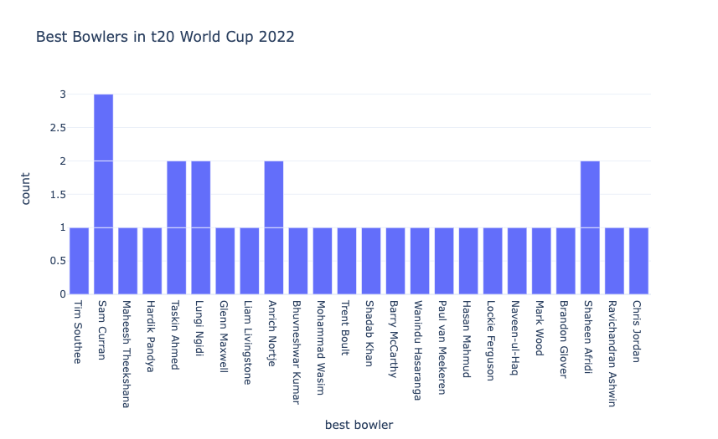

Slide 25
Sam Curran was the only best bowler in 3 matches. Undoubtedly, he deserved to be the player of the tournament.

Slide 26
Now let’s compare the runs scored in the first innings and second innings in every stadium of the t20 world cup 2022:
FIG = GO.FIGURE()
FIG.ADD_TRACE(GO.BAR(
X=DATA["VENUE"],
Y=DATA["FIRST INNINGS SCORE"],
NAME='FIRST INNINGS RUNS',
MARKER_COLOR='BLUE'
))
FIG.ADD_TRACE(GO.BAR(
X=DATA["VENUE"],
Y=DATA["SECOND INNINGS SCORE"],
NAME='SECOND INNINGS RUNS',
MARKER_COLOR='RED'
))
FIG.UPDATE_LAYOUT(BARMODE='GROUP',
XAXIS_TICKANGLE=-45,
TITLE="BEST STADIUMS TO BAT FIRST OR CHASE")
FIG.SHOW()

Slide 27
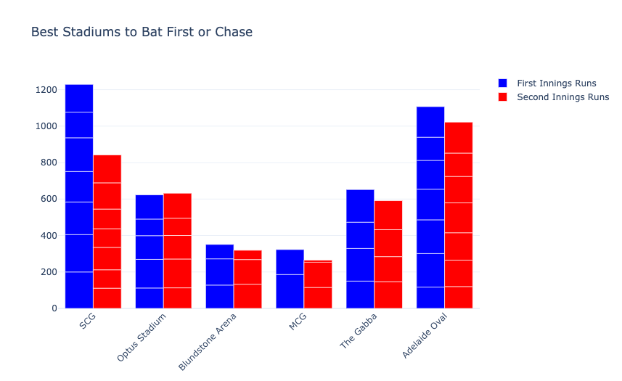

Slide 28
So SCG was the only stadium in the world cup that was best for batting first. Other stadiums didn’t make much difference while batting first or chasing.

Slide 29
Now let’s compare the number of wickets lost in the first innings and second innings in every stadium of the t20 world cup 2022:
FIG = GO.FIGURE()
FIG.ADD_TRACE(GO.BAR(
X=DATA["VENUE"],
Y=DATA["FIRST INNINGS WICKETS"],
NAME='FIRST INNINGS WICKETS',
MARKER_COLOR='BLUE'
))
FIG.ADD_TRACE(GO.BAR(
X=DATA["VENUE"],
Y=DATA["SECOND INNINGS WICKETS"],
NAME='SECOND INNINGS WICKETS',
MARKER_COLOR='RED'
))
FIG.UPDATE_LAYOUT(BARMODE='GROUP',
XAXIS_TICKANGLE=-45,
TITLE="BEST STATIUMS TO BOWL FIRST OR DEFEND")
FIG.SHOW()

Slide 30
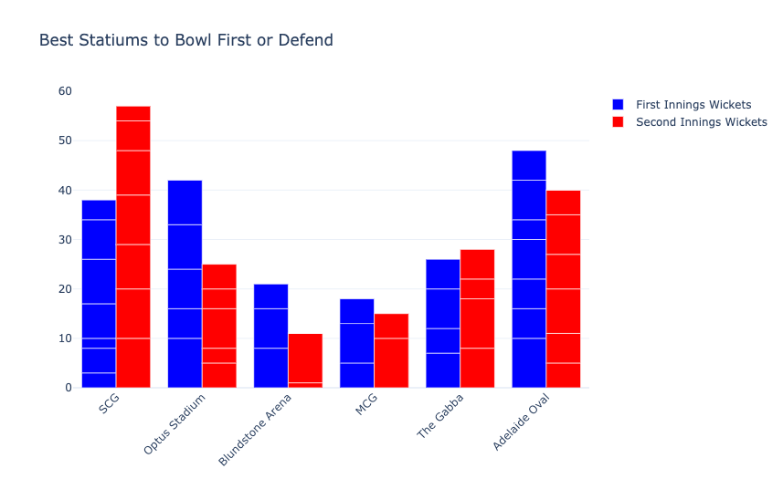

Slide 31
SCG was the best stadium to bowl while defending the target. While the Optus Stadium was the best stadium to bowl first.

Slide 32
So some highlights of the t20 world cup 2022 I found from this analysis
England won the most number of matches
Virat Kohli scored highest in the most number of matches
Sam Curran was the best bowler in the most number of matches
More teams won by batting first
More teams decided to bat first
SCG was the best stadium to bat first
SCG was the best stadium to defend the target in the World Cup
The Optus Stadium was the best stadium to bowl first

Slide 33
Thank you!

